Slide 1
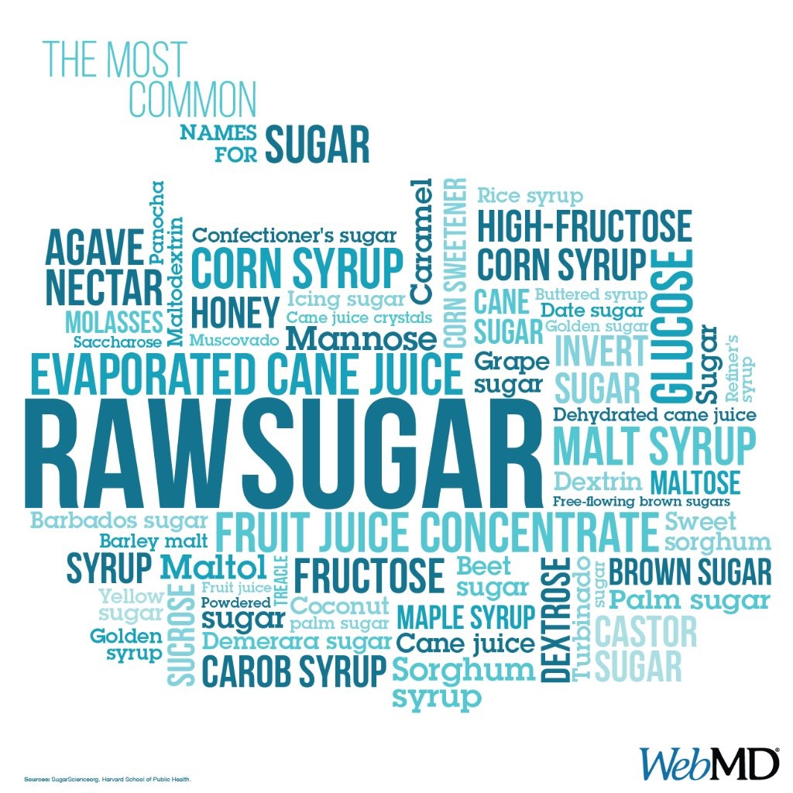
Body Mass Index and Sugar Consumption in School Children in Malta
Paula Vassallo
Ethel Vento Zahra

Slide 2
STUDY
DATA IN 3 AND 12 YEAR OLDS COLLECTED AS PART OF THE NATIONAL ORAL HEALTH SURVEY
DATA IN 8 YEAR OLDS COLLECTED AS PART OF THE COSI
STRATIFIED RANDOM SAMPLING
ALL TYPES OF SCHOOLS
DATA COLLECTED 2014 – 2016
DATA ANALYSED USING PEARSONS CORRELATION
#PHSymposium17

Slide 3
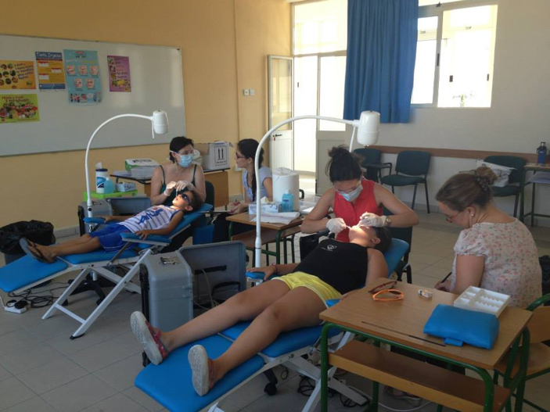
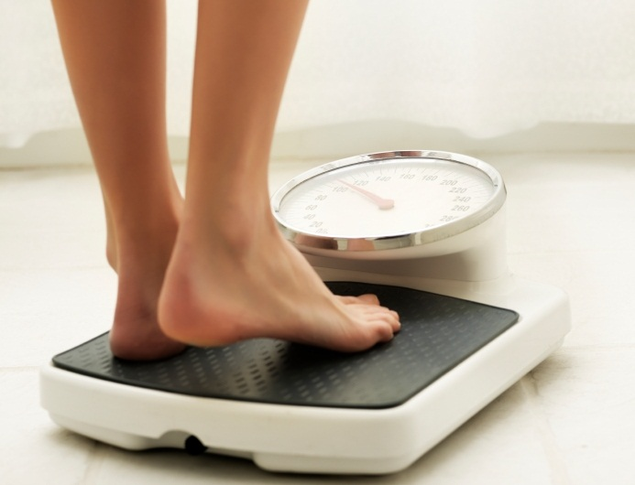
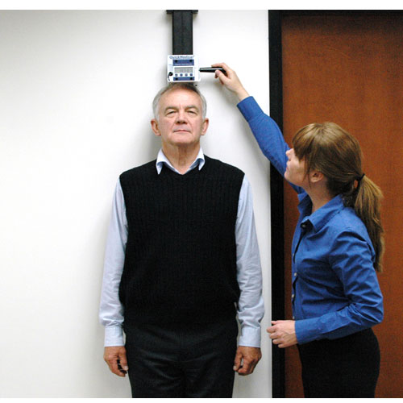
STUDY
BMI measurements
Dental examination
Questionnaire
parents (3 and 8 year olds)
self administered (12 year olds)

Slide 4
 | NEVER | LESS THAN ONCE A WEEK | 1-2 TIMES A WEEK | 0NCE A DAY | 2-4 TIMES A DAY | MORE THAN 4 TIMES A DAY
FRESH FRUIT
BISCUITS,
JAM/ HONEY
SUGAR FREE CHEWING GUM
CHEWING GUM
CHOCOLATES
SWEETS (e.g. toffee, wine gums)
FIZZY DRINKS (e.g. lemonade/cola)
FLAVOURED MILK
HOT CHOCOLATE DRINKS
TEA/COFFEE WITH SUGAR
FRESHLY SQUEEZED ORANGE JUICE
PACKAGED JUICES
FRUIT SMOOTHIES
SQUASHES, ICED TEA
FLAVOURED WATER
HERBAL TEA
SPORTS DRINKS
CEREAL BARS
CRISPS
NATURAL YOGHURS
FRUIT/ FLAVOURED YOGHURT
MINTS
KETCHUP
SALAD DRESSINGS (e.g. mayonnaise)

Slide 5
STUDY
Age (years) | Number of participants | Response rate (%)
3 | 346 (263) | 76.23
8 | 367 (272) | 74.1
12 | 604 (599) | 99.17

Slide 6
BMI in 3 year olds (IOTF cut off points)

Slide 7
BMI IN 8 YEAR OLDS (IOTF cut off point)

Slide 8
BMI IN 3, 8 AND 12 YEAR OLDS (IOTF)

Slide 9
RESULTS/ANALYSIS
Correlations
 |  | Obesity
fresh fruit | Pearson Correlation | -.059
 | Sig. (2-tailed) | .048
 | N | 1121
Negative Correlation between Fresh Fruit consumption and BMI

Slide 10
Results in 3 year olds
natural yoghurt | Pearson Correlation | -.140
 | Sig. (2-tailed) | .026
 | N | 251
Natural Yoghurt is negatively correlated with BMI

Slide 11
Results in 8 year olds
fresh fruit | Pearson Correlation | -.163
 | Sig. (2-tailed) | .008
 | N | 265
biscuits etc | Pearson Correlation | -.169
 | Sig. (2-tailed) | .006
 | N | 264
fizzy drinks | Pearson Correlation | .157
 | Sig. (2-tailed) | .011
 | N | 264
Fresh Fruit and Biscuits are negatively correlated with BMI
Fizzy Drinks are positively correlated with BMI

Slide 12
Results in 12 year olds
chocolates | Pearson Correlation | .108
 | Sig. (2-tailed) | .009
 | N | 590
biscuits | Pearson Correlation | .129
 | Sig. (2-tailed) | .002
 | N | 595
crisps | Pearson Correlation | .095
 | Sig. (2-tailed) | .021
 | N | 590
Biscuits, Chocolates and Crisps are positively correlated with BMI

Slide 13
Acids
Caffeinated
Different flavours
Energy drinks
2000 different non alcoholic beverage brands
in the EU market
Juice based drinks
Sports drinks
+ Vitamins
Caloric
Carbonated drinks
New age drinks
Ready to drink teas
9000
when considering all the flavours
Smoothies
+ Minerals
Sweetened drinks
Dairy based drinks
100,000 options
when including sizes and packaging options
Functional drinks
Non caloric
Still drinks
Dilutables - sqashes
Ready to drink coffees
Different sweeteners
Caffeine free
Flavoured drinks
Meet our needs
Hydration , balance and wellness
Great taste and convenience
Notes:
A functional beverage can be defined as a drink product that is non-alcoholic, ready to drink and includes in its formulation non-traditional ingredients. This includes herbs, vitamins, minerals, amino acids or additional raw fruit or vegetable ingredients, so as to provide specific health benefits that go beyond general nutrition. Sports and performance drinks, energy drinks, ready to drink (RTD) teas, enhanced fruit drinks, soy beverages and enhanced water, among others, are some of the product segments rolled out as functional beverages in the market space.^{[1]}
Functional beverages have become popular due to its appeal to consumers who are seeking specific health benefits in their foods and beverages with their 'healthiness-on-the-go' idea. Both convenience and health have been identified as important factors when consumers make decisions about purchasing foods and beverages. Functional drinks are promoted with benefits such as heart health, improved immunity and digestion, joint health, satiety, and energy-boosting.^{[2]}

Slide 14
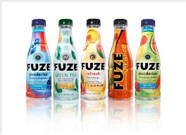
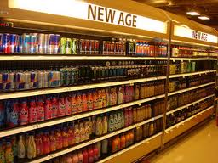
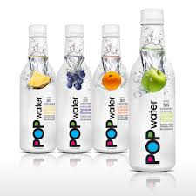
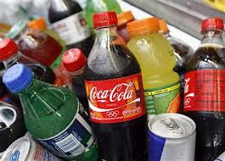
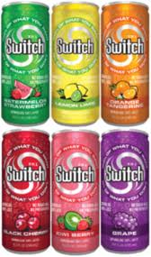
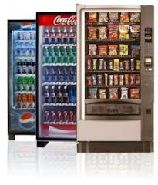
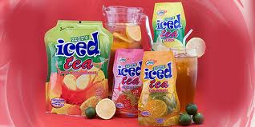
BEVERAGES
The European non-alcoholic beverages market totals some
123 billion litres per year
There are over 1000 soft drinks production plants across Europe,
employing some 250,000 people
boosting the economy

Slide 15
“The high and increasing consumption of sugars-sweetened drinks by children in many countries is of serious concern. It is estimated that each additional can or glass of sweetened drink that they consume every day increases risk of becoming obese by 60%.”
WHO, 2003

Slide 16
Conclusions
Address soft drink consumption
Continue to promote fruit consumption
Upstream Approach
Whole of Government Approach
Cost of Obesity
Sustainability of Health Care System

Slide 17
Upstream - downstream interventions
National &/or local policy initiatives
Legislation/Regulation
‘Upstream’
Healthy Public Policy
Fiscal Measures
Healthy Settings- HPS
Community Development
Training other professional groups
Media Campaigns
School health education
Chair side health education
‘Downstream’
Health Education & Clinical Prevention
Clinical Prevention
Watt, (2007)

Slide 18
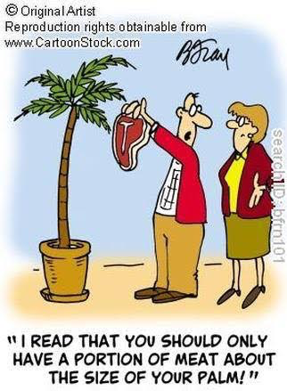
Thank you

